Slide 1
HiAP & SDOH:
Making sense of our alphabet soup
HEALTH IN ALL POLICIES WORKSHOP
NMPHA Health Policy Legislative Forum
Tuesday, December 9, 2014
Embassy Suites
Albuquerque, NM
Presented by the Health in All Policies Work Group
Notes:
Welcome everyone! I’m Marsha McMurray-Avila, the Coordinator for the Bernalillo County Community Health Council and the Chair of the NM Alliance of Health Councils. I am also coordinating a project for the New Mexico Public Health Association with funding recently received from the American Public Health Association to share information on the Health in All Policies approach as a way to move us toward healthy policies in our state that address the social determinants of health and health equity.
Our planning committee includes multiple partners: NMPHA, the NM Alliance of Health Councils, individual health councils in Bernalillo and Torrance Counties, Place Matters chapters in Bernalillo, Dona Ana and McKinley Counties, the NM Department of Health, the NM Health Equity Partnership, the Bernalillo County Office of Health & Social Services Health Promotion Team, the NM Chronic Disease Prevention Council and others.

Slide 2
What we’ll cover today…
Review of social determinants of health and equity
Description of Health in All Policies as approach to operationalize how to address the social determinants of health and equity
      Definition and context
      Key elements
      History and background
      Strategies to implement Health in All Policies
Examples of tools from the HiAP Toolkit
Practice with implementation tools for working at the local level
Notes:
What we want to provide in this workshop today is:
A quick review of the social determinants of health so that we’re all on the same page, followed by a description of HiAP so that you can see how it is an approach that helps us to actually operationalize our understanding of SDOH.
We’ll also take a look at some tools we’re putting into our toolkit.
And then we’ll give your teams the chance to practice with your choice of a couple of tools.

Slide 3
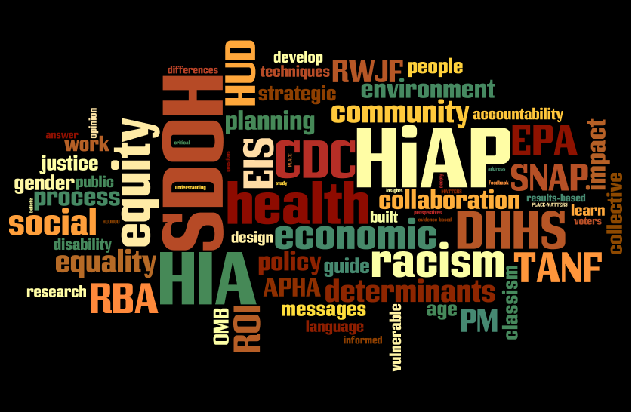
2014 NMPHA/M. McMurray-Avila
Notes:
So on to the alphabet soup – this is probably what the thought bubble looks like over our heads to folks in the community who don’t live in our community health world. And this is what my brain often feels like!
So let’s start to break it down…

Slide 4
What determines how healthy we are?
GENETICS
MEDICAL CARE
INDIVIDUAL BEHAVIORS
2012 NMAHC/M. McMurray-Avila
Notes:
Three things that come up most often when you ask people on the street “What determines how healthy you are?” There are lots of different versions of this out there, but do you want to say what you’ve heard in terms of the percentage each of these contributes?

Slide 5
What determines how healthy we are?
GENETICS
MEDICAL CARE
5%
10%
INDIVIDUAL BEHAVIORS
30%
2012 NMAHC/M. McMurray-Avila
Notes:
What determines how healthy we are? Depending on which research or article you look at, it might come out something like what you see in the next slide. Although listed in one article I was reviewing as 5%, genetics I’ve also seen as high as 10-15%. But the impact of medical care tends to usually be around 10%, and at least a third is due to individual behaviors. Of course, it’s immediately obvious that this does not add up to 100%. There’s a big chunk missing. That other 55% or so is what REALLY determines how healthy we are…

Slide 6
https://www.youtube.com/watch?v=_11xLlwKgWc
CHAD & JEFF

Slide 7
What (really) determines how healthy we are?
2012 NMAHC/M. McMurray-Avila
Notes:
So here is a long list of some of the most recognized social, economic, and environmental determinants of health, many of which you just saw illustrated in the video.
However, the other thing we saw illustrated in the video is that all of these factors are greatly impacted by other social forces that determine the quality and quantity of resources available to individuals and communities in any of these areas. These are the Determinants of Equity…as shown in the next slide…

Slide 8
Equitable Access & Opportunities for All
2012 NMAHC/M. McMurray-Avila
Notes:
We know that poverty, racism, classism, sexism and any other form of discrimination are inequities that have a major impact on the quality and availability of all of these determinants from the built environment all the way through this list down to the working conditions. For this reason, equity is a key principle and value to keep in mind in the following discussion of health in all policies.
(Ask for examples from audience first, then add these below if not mentioned):
Built Environment – when sidewalks are lacking in poor neighborhoods of color, preventing children from walking safely to school
Education - when policies discourage students through punitive actions such as suspension/expulsion leading to dropping out, rather than providing the appropriate supports to encourage youth to stay in school and graduate (which leads to better health as an adult)
Land Use Policy – when polluting industries are concentrated in poorer neighborhoods, causing increased cancer, asthma, etc.
Transportation - when affordable, accessible mass transit is not available in poor neighborhoods so that people’s health could be improved directly (by walking to and from the bus stop) and indirectly (by improving access to meaningful work or healthy food or necessary services)
Working Conditions – in addition to the obvious impact on health of unsafe working conditions or toxic environments (both physical and emotional) health is also an issue when employees suffer from wage theft (substandard or with-held wages) preventing the ability of the worker to make healthy choices in housing or food, as well as increasing stress leading to further illness

Slide 9
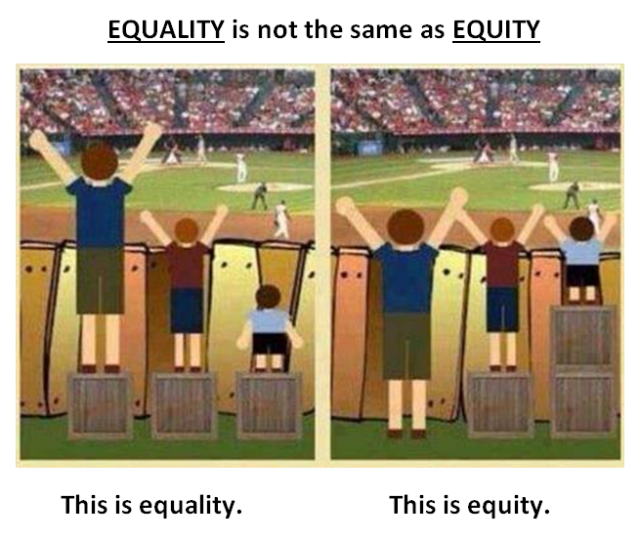
Notes:
A further word about equity. Equity is not the same as equality. As you can see here on the left, all children have equal boxes. But the results are not fair. On the right the resources have been distributed so that all have an equal opportunity to see the game. Equity is what assures that everyone has the appropriate resources so that all have an equal opportunity. I’ve also heard this described as “Equality is giving everyone a pair of shoes. Equity is giving everyone a pair of shoes that fits.”

Slide 10
Examples of tools for understanding the social determinants of health – from our Toolkit http://www.nmpha.org/HiAP_toolkit
Notes:
As a first introduction to the toolkit and specifically the SDOH tools, show the sections on Communications, Exercises and Videos.

Slide 11
So what are health policies?
Transportation policy is health policy
Land use policy is health policy
Education policy is health policy
Tax policy is health policy
Agricultural policy is health policy
Economic development policy is health policy
Criminal justice policy is health policy
Notes:
So once you begin seeing health more broadly from a SDOH perspective, you realize that policies in any of these sectors are health policy. What might be some examples of these? (Mention those below if not offered by participants.)
Tax policy is health policy – when Earned Income Tax Credits help lift a family out of poverty, allowing that extra money towards safe housing or education or healthier food
Agricultural policy is health policy – when growing healthy food is subsidized or when small organic farmers are linked to providing food for schools or businesses
Economic development policy is health policy – when jobs are created that provide a living wage so that families can afford to make healthier choices in what they eat, where they live, providing safe quality childcare, etc.
Criminal justice policy is health policy – decriminalization of drug use or offering treatment as an alternative to incarceration for people suffering from addictions who commit non-violent crimes have an enormous impact not only on the health of the individual and the chances for a better healthier life in the future, but also have a major impact on that individual’s family. Children of incarcerated parents do worse in school and have poorer physical and mental health outcomes.

Slide 12
SUMMARY: What is health and where does it come from?
Health is “a state of complete physical, mental and social well-being and not merely the absence of disease or infirmity.” (World Health Organization)
Public health is “what we as a society do to collectively assure the conditions in which people can be healthy.” (Institute of Medicine, 1988)
Those conditions can be described as the places where we live, learn, work, and play, and the social, economic and political factors that affect us in those places.
Notes:
So in a world where the word “health” is often interpreted to mean “health care” this may all sound confusing. Perhaps these definitions might help.
The World Health Organization defines health as “a state of complete physical, mental and social well-being and not merely the absence of disease or infirmity.”
And the Institute of Medicine in 1988 declared that public health is “what we as a society do to collectively assure the conditions in which people can be healthy.”
Those conditions are often described today as the places where we live, learn, work, and play, and the social, economic and political factors that affect us in those places.

Slide 13
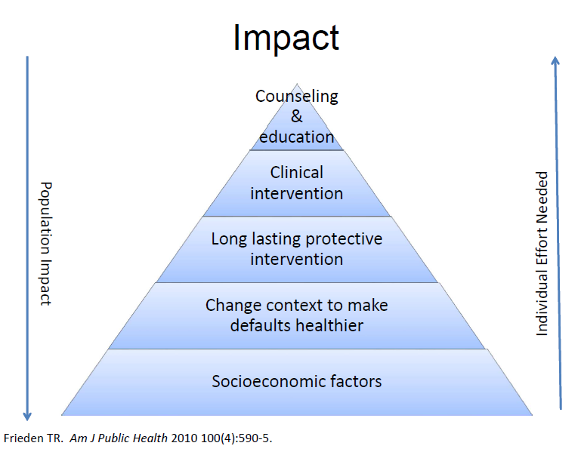
Notes:
In this slide from Tom Frieden of the CDC, you can see how the impact on the health of the entire population is greatly maximized by focusing on the bottom of the pyramid where we find the socioeconomic factors which represent those conditions we are working to improve. At the top are individual solutions that may help a few people, but do much less to change the overall health of the population. It is of note that clinical intervention, i.e., medical care, is near the top of the pyramid… much less impactful in creating a healthy society, but clearly the most costly of all efforts shown.

Slide 14
The Economic Impact of Poor Health
Chronic disease has an economic impact in New Mexico. In 2007 the Milken Institute estimated that significant reductions in obesity and other chronic disease-related risk factors could save New Mexico over $6 billion in treatment-related costs as well as costs due to lost work productivity by 2023.
A 2009 report from the New Mexico Department of Health stated that, “an estimated $390 million was spent overall in New Mexico on healthcare services for heart disease; lost productivity amounted to an additional $780 million in New Mexico.”
Notes:
These statistics illustrate what we saw in the pyramid. If we address the root causes of poor health and start creating and implementing laws with the community’s health in mind, it could save New Mexico billions of dollars!

Slide 15

Context…
The public health challenges of the 21st century are extremely complex, and solutions will require actions that go beyond the purview of public health, bringing together partners across policy areas and sectors.
Messy, wicked problems
Notes:
And since real life does not usually divide itself neatly into pyramid charts, let’s add some context. We all know the challenges we face. They’re extremely complex and the solutions go way beyond our public health boundaries. These kinds of complex problems are also known as wicked problems or social messes.

Slide 16
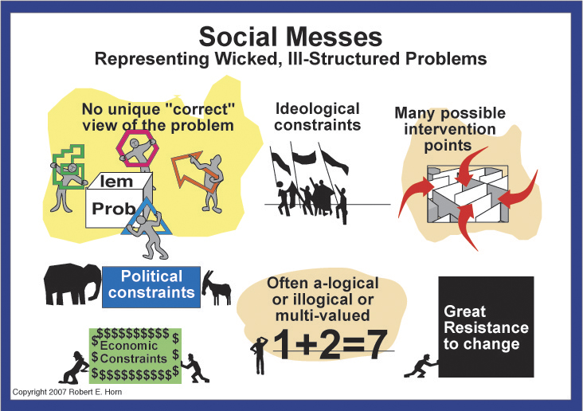
Notes:
Here you see a graphic look at why we call these social messes. I’m sure you can relate this to many of the problems you all deal with yourselves in your own work. First, there is no unique or “correct” view of the problem. There are many ideological, political and economic constraints. There are many possible intervention points or ways to solve the problem. Frequently neither the issue nor the results is linear. The synergy of 1 + 2 may actually equal 7. And, of course, in trying to solve these wicked problems, there is great resistance to change.

Slide 17
That’s all great in theory…
How do we put it into practice?
“Health in All Policies” (HiAP) is a way to operationalize the understanding that our health is affected by multiple sectors of our society and those sectors all have a role to play in helping us get and stay healthy.
HiAP is a collaborative approach to improving the health of all people by incorporating health considerations into decision-making across sectors and policy areas.
HiAP, at its core, is an approach to addressing the social determinants of health that are the key drivers of health outcomes and health inequities.
HiAP is an approach, a process and a philosophy.
Notes:
So… this is a lot of words to describe some powerful concepts. But clearly, just talking about the social determinants of health or equity is not going to change health outcomes or make communities healthier or more equitable or clean up all these social messes and wicked problems. Here we see how Health in All Policies is a way to actually operationalize and put into practice this understanding of social determinants of health, recognizing that we need all the different sectors involved in this work that play a role in creating (or negatively impacting) health.
The primary definition of HiAP is a collaborative approach to improving the health of all people by incorporating health considerations into decision-making across sectors and policy areas.
At its core this is an approach to addressing the social determinants of health we looked at before, that are the key drivers of health outcomes and health inequities.
It’s also important to note that HiAP is an approach, a process and a philosophy. It is not a fixed step-by-step methodology like Health Impact Assessments, which are one tool that can be used in this process.

Slide 18
HiAP – 5 Key Elements
Promote health, equity and sustainability
Support intersectoral collaboration
Benefit multiple partners
Engage stakeholders
Create structural or procedural change
Notes:
Again, in summary, HiAP is an approach to get different sectors to collaborate on solving problems that affect our health by supporting healthy policies.
Here are the principles that must be included in HiAP work.
Promote health, equity and sustainability
Support intersectoral collaboration
Benefit multiple partners
Engage stakeholders
Create structural or procedural change
We’ll now go into each of these individually…

Slide 19
1. Promote health, equity and sustainability
HiAP promotes health, equity and sustainability
through two avenues:
Incorporating health, equity and sustainability into specific policies, programs, and processes, and
Embedding health, equity and sustainability considerations into government decision-making processes so that healthy public policy becomes the normal way of doing business. Promoting equity is an essential part of HiAP given the strong ties between inequity and poor health outcomes.
Notes:
The overall purpose or outcome is promotion of health, equity and sustainability. This can be done either at the level of individual policies, programs or processes (which is one of the places we use Health Impact Assessments) OR by embedding into the actual government decision-making processes so that healthy public policy becomes the normal way of doing business, with the promotion of equity in a central role.

Slide 20
2. Support intersectoral collaboration
HiAP brings together partners from many sectors to:
recognize the links between health and other issue and policy areas,
break down silos,
build new partnerships to promote health and equity, and
increase government efficiency.
Notes:
Moving to #2 – This can clearly only be accomplished through collaboration across sectors… breaking down the silos and building new partnerships is key to this approach.

Slide 21

Breaking down silos…
LAND USE PLANNING
EDUCATION
ECONOMIC
DEVELOPMENT
TRANSPORTATION
Sectors that are not typically considered as health sectors play a major role in shaping the economic, physical, social, and service environments in which people live, and therefore have an important role to play in promoting health and equity.
Notes:
An additional word on silos here… Think about those sectors that are not typically considered as health sectors and the role that they play in shaping the economic, physical, social and service environments in which people live, for example land use planning, education, transportation, economic development. We clearly cannot promote health and equity without getting past this silo mentality and working together.

Slide 22
Breaking down silos…
UNM
NON-PROFIT
ORGANIZATIONS
BERNALILLO COUNTY
NMDOH
Institutions also have a tendency to function from their silos, often with “silos within silos” where even within the institution not all offices/departments/initiatives know what each other are doing or how they could be collaborating.
Notes:
Silos may develop within sectors, but also within institutions. Within large institutions it’s extremely common to find silos within silos. The “Russian nesting doll” syndrome. Even people working in the same office may not know what each other are doing. Again… We cannot promote health and equity without getting past this silo mentality and working together. How many of you have noticed that you feel like you’re working within a silo?

Slide 23
The Silo Culture Impedes HiAP
Defining characteristics of silos include:
distinct funding streams – governmental budgets directed to specific departments
competition for funding and credit
self-preservation within the system
Notes:
So that it doesn’t just become another buzz word we throw around, let’s define a little of what creates the silo mentality wherever it’s found. In this slide we see that the culture of silos is defined by characteristics that include (among others):
Distinct funding streams, for example, when governmental budgets are directed to specific departments, rather than to specific issues that could be worked on collectively by several departments. Or categorical funding goes to non-profit organizations that limits their ability to work with others.
This creates competition not only for funding, but also for credit (since that is often seen as leading to more funding)
- And the result of all this is a state of self-preservation within the system – self-preservation trumps innovation and survival trumps service.

Slide 24
3. Benefit multiple partners
HiAP is built upon the idea of “co-benefits” and “win-wins.” HiAP work should benefit multiple partners, simultaneously addressing the goals of public health agencies, other government agencies and community stakeholders to benefit more than one end (achieve co-benefits) and create efficiencies across sectors (find win-wins).
Notes:
This last point of self-preservation is key to the 3rd principle in the next slide. Everyone in all these silos needs to feel that they’re benefitting (and that their survival is not immediately threatened). We need to find solutions that are “co-benefits” and “win-wins” – solutions that can have more than one positive outcome in more than one sector. I sort of think of this as coaxing people out of their silos with incentives and benefits and valuing their priorities, rather than just going in and breaking down their silo in a destructive or disrespectful way.

Slide 25
Co-benefits
Public health practitioners have a unique role to play in improving the quality of life in our nation, but genuine efforts to improve health must be made in partnership with other sectors.
The concept of co-benefits is essential for:
securing support from partners
reducing redundancies, and
ensuring more effective use of scarce government resources.
Finding a balance between multiple goals will sometimes be difficult, and requires negotiation, patience, and learning about and valuing others’ priorities.
AVOID PUBLIC HEALTH IMPERIALISM
Notes:
An additional word on co-benefits… Public health practitioners have a unique and vital role to play in this, but we can’t do it alone. And we have to make sure that all partners benefit in order to secure their support as well as to make the system work better and use our resources wisely. This isn’t easy. It’s difficult and requires negotiation, lots of patience and a deep understanding of what the priorities and values are of our partners.
In this, we have to avoid public health imperialism. I know myself, I want so badly for everyone to see themselves as working in public health. But our partners in other sectors also like to see themselves as the center of the world that everything else connects to. We won’t make friends or establish lasting relationships if we don’t accept that.

Slide 26
4. Engage stakeholders
HiAP engages a variety of stakeholders, beyond government partners, such as community members, policy experts, advocates, the private sector, and funders. Robust stakeholder engagement is essential for ensuring that work is responsive to community needs and for garnering valuable information necessary to create meaningful and impactful change.
Notes:
The 4th principle seen in this slide is to always engage stakeholders. In HiAP lingo, “partners” are within government and “stakeholders” are those outside of government, like community members, policy experts, advocates, the private sector and funders. Whether we call them stakeholders or community partners, they must be engaged as a fundamental part of this work – both to insure that the work is responsive to community needs and to make sure we have all the information necessary for meaningful change.
THIS is a key role for all of us here – assuring that community stakeholders are always involved.

Slide 27
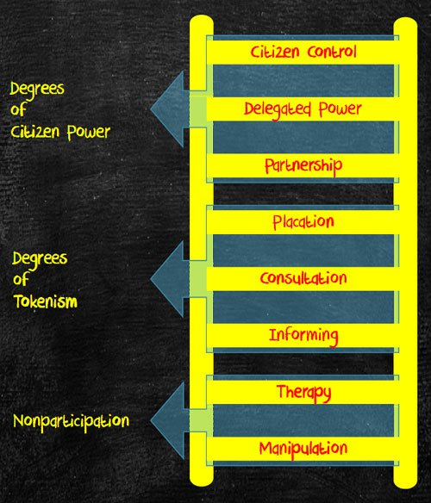
Notes:
How many of you are familiar with Ladders of Community Participation? This is one of the early depictions of the Ladder of Community Participation – this one by Arnstein started with a level of non-participation that included manipulation and therapy. And describes this middle section as “tokenism”

Slide 28
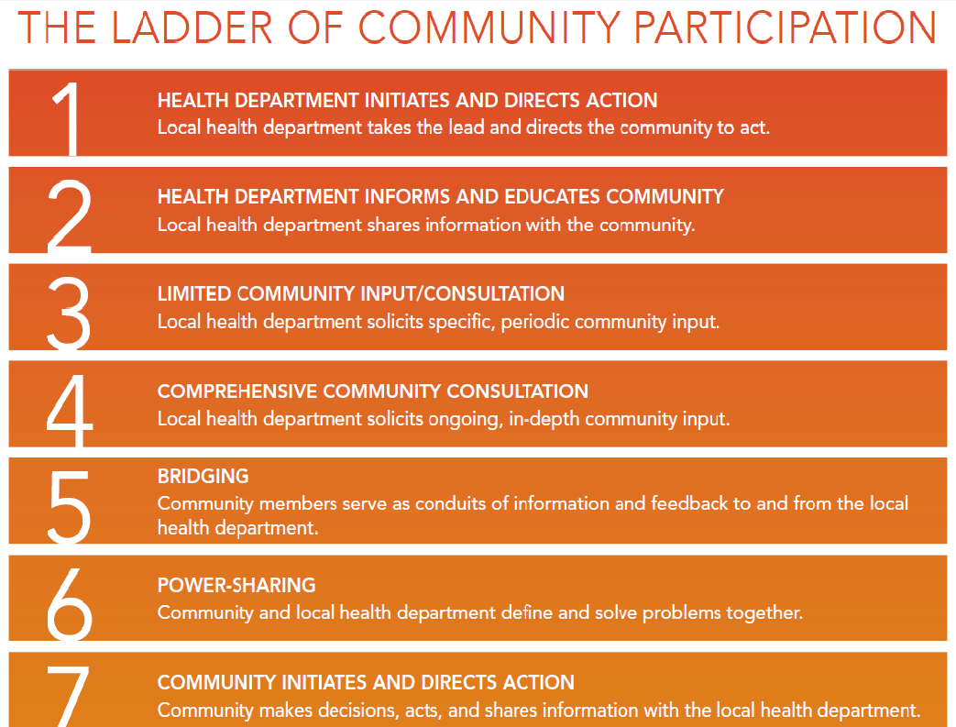
Notes:
A more recent version that is specific to health departments starts at the top ( in top-down form) with the health department pretty much making all the decisions and goes through several levels all the way down to where the community itself initiates the action and makes decisions – then sharing it with the health department. How do we find the best, most effective ways to work together for change that value and acknowledge the wisdom of people in the communities that are being most impacted by health inequities?

Slide 29
5. Create structural or procedural change
Over time, HiAP creates permanent changes in how agencies relate to each other and how government decisions are made. This requires maintenance of:
structures which can sustain intersectoral collaboration
mechanisms which can ensure a health and equity lens in decision-making processes across the whole of government.
This can be thought of as “embedding” or “institutionalizing” HiAP within existing or new structures and processes of government.
Notes:
So the last principle is that HiAP should result in permanent changes in how government decisions are made, as well as how agencies and organizations relate to each other and work together. This can require new structures that are able to sustain intersectoral collaboration, as well as processes that can ensure a health and equity lens in decision-making across all government entities. This is where we talk of embedding or institutionalizing HiAP into the decision-making process.

Slide 30
Strategies for implementation
HiAP actions and groups can take many forms. It can be implemented through:
creation of a new structure or group, e.g., task force
application to existing processes such as strategic planning, individual initiatives and grant-making
or both
Many options exist for how to consider health in decision-making, from using formal health impact assessment tools to an informal application of a health lens. Partners, leaders, and focus areas will vary, depending upon political support, community needs, and resources.
Notes:
There are many ways this can be done. It could be through establishment of a new task force or other group or structure or applied to processes already ongoing - such as strategic planning, grant-making or other initiatives - or both.
And there are many ways to incorporate the consideration of health into decision-making, from using formal HIA tools as mentioned before, to an informal application of what we call a health lens.

Slide 31
Creation of New Structures:
Examples of Formalizing
Health in All Policies Work
Rhode Island Commission for Health Advocacy and Equity (2011)
Healthy Chicago (2011)
Seattle/King County Equity Ordinance (2010)
California Health in All Policies Task Force (2010)
Notes:
Let’s take a look at the bigger picture approach of embedding HiAP into all areas of government decision-making, there are numerous examples of how HiAP has been formalized in several locations across the country from local governments to state governments, from Rhode Island to Chicago and Seattle/King County. We’ll be providing a little background specifically on the California experience since they were pioneers in this at the state level.

Slide 32
New Mexico
Health in All Policies Task Force
Our HiAP Work Group requests the formation of a Health in All Policies Task Force consisting of multi-sectoral representatives of departments in state government, as well as multi-sectoral stakeholders from community-based organizations, either:
Legislatively through a Memorial OR
Administratively by building on the NMDOH current long-range planning process
Notes:
But first, we wanted to let you know that our work group has requested of the Legislative Health & Human Services interim committee the formation of a NM Health in All Policies Task Force consisting of multi-sectoral representatives of departments in state government, as well as multi-sectoral stakeholders from community-based organizations and local government agencies.
This could be done legislatively through a Memorial OR administratively by building on an existing long-range planning process within DOH which I believe is looking ahead to 2030.
Examples of the departments:
Department of Health
Department of Transportation
Environment Department
Aging & Long-Term Services
Department of Agriculture
Children, Youth & Families Department
Human Services Department
Corrections Department
Department of Public Safety
Energy, Minerals & Natural Resources Department
Economic Development Department
Public Education Department etc etc etc etc etc w/ multi-sector community stakeholders

Slide 33
California HiAP Task Force: Establishment
2010: Executive Order by Gov. Schwarznegger directs Strategic Growth Council (SGC) to establish Health in All Policies Task Force
  Purpose: “to identify priority programs, policies and strategies to improve the health of California while advancing the SGC’s goals”
  Facilitated by CA Dept of Public Health (CDPH)
  Extensive engagement of stakeholders
2012: HiAP Task Force recognized by Senate Concurrent Resolution and codified within newly established Office of Health Equity in CDPH
Task Force meetings staffed through partnership with Public Health Institute, funded by California Endowment and others
Notes:
So here’s the example of how this has been done at the state level in California. We have extensive information on the California experience in this “HiAP: Guide for State and Local Governments” for anyone who is interested in more detail. (SHOW GUIDE)
The California HiAP Task Force was established in 2010 by Executive Order by Gov. Schwarzenegger, building on the Strategic Growth Council they had established in statute in 2008. The Task Force is facilitated by the CA Dept of Public Health, with extensive engagement of stakeholders, staffed in partnership with the Public Health Institute and funded in part by the California Endowment.

Slide 34





California HiAP Task Force:
Aspirations for All Californians
Option to safely walk, bike or take public transit to school,
work and essential destinations
Live in safe, healthy, affordable housing
Access to places to be active, including parks,
and healthy tree canopy
Live and be active in communities
without fear of violence or crime
Access to healthy, affordable foods
at school/work/near home
California’s decision-makers are informed about the health consequences of various policy options
in the policy development process
Notes:
In this slide you see the aspirations they set for themselves – their practical vision. Although this is not a comprehensive prevention strategy, they chose those things they could work on now, like physical activity, transportation, healthy housing, parks, safe neighborhoods free from violence and crime, and access to healthy food. These are themes that you’ll see across the country these days – the movement to “make the healthy choice the easy choice” in the areas of healthy eating and active living in particular.
It’s important to note that their most important overall aspiration is that California’s decision-makers be informed about the health consequences of various policy options in the policy development process.

Slide 35
California HiAP Task Force:
What is our value added?
“What unique role can we play as a state-level body?”
Facilitating collaboration: convening/aligning goals across agencies
Building cross-sectoral understanding, especially where causal relationships are not obvious
Shaping funding streams/affecting allocations
Providing analytic tools & guidance for local decision-making
Gathering & sharing data, through stakeholders’ engagement & otherwise
Notes:
Moving to the next slide, the California HiAP Task Force asked itself the following question “What unique role can we play as a state-level body?” and the answers provide some ideas for beginning to define the role of a statewide task force here – or could also be applied to a task force at the local government level:
Facilitating collaboration: convening/aligning goals across agencies
Building cross-sectoral understanding, especially where causal relationships linking different sectors and health are not obvious
Shaping funding streams/affecting allocations
Providing analytic tools & guidance for local decision-making
Gathering & sharing data, through stakeholders’ engagement & otherwise

Slide 36
Starting with existing processes, projects & policies:
Look for “Windows of Opportunity”
Opportunistic approach – Identify existing issues, policies or relationships that can provide early success for all partners
Issue approach – Identify policies that have major impact on specific public health priorities (e.g., violence prevention, hunger alleviation, or reduction of poverty)
Sector approach – Focus on one specific policy area with a large health impact
(e.g., transportation or agriculture)
Notes:
That was all about the creation of new structures and macro-processes. The second implementation strategy – that can definitely be pursued simultaneously with the first strategy - is to start with existing processes, projects and policies. Here are three different “windows of opportunity” to start identifying how to inject HiAP into different processes… (READ and explain)

Slide 37

Opportunistic Approach:
Food for Thought…
Are there any existing or newly forming interagency initiatives that have potential health implications?
What single-agency initiatives would benefit from partnership with additional agencies?
Is your agency, or is another agency, going through a strategic planning process?
Is there a new or ongoing process where health metrics or data could be added?
What partners have you worked with successfully in the past?
Notes:
Looking at the Opportunistic Approach, here is some “Food for Thought” from the HiAP Guidebook for Local & State Governments that are questions you could ask. We’re actually going to use this for our small group discussion after the break.

Slide 38
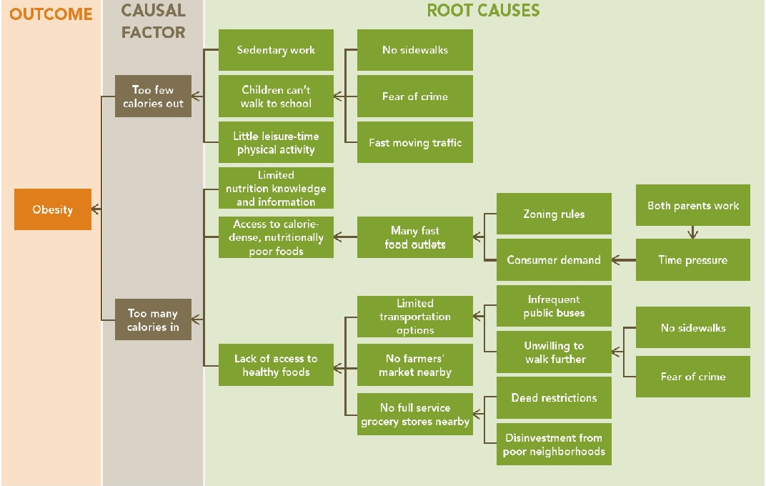
Issue Approach: Root Cause Map
Lack of physical activity
Lack of healthy food
Notes:
Here’s an example of how you can take one issue – like obesity – and then look at the root causes to the far right to get ideas of what sectors need to be involved. No sidewalks = which government agency? (Public Works); Fast moving traffic = which agency? (Traffic Engineering); Zoning rules = which agency? (Land Use Planning); Infrequent public buses = which agency? (Transit Department); Disinvestment in poor neighborhoods = which agency? (Economic Development). Etc, etc.

Slide 39
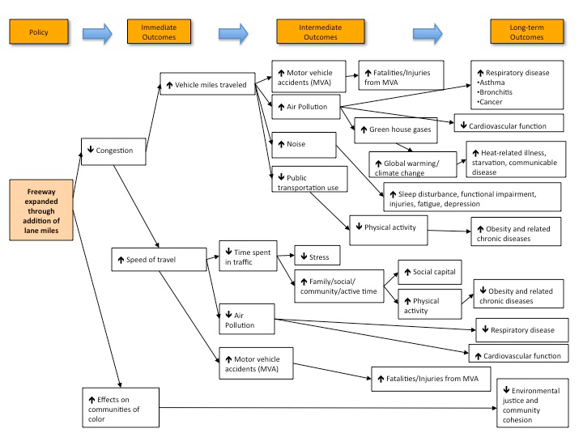
Sector Approach: Transportation
Notes:
For the Sector Approach, you could start by choosing a sector, e.g., Transportation, and then through a pathways diagram help illustrate for partners in that sector all the different places that their work impacts on health. Human Impact Partners has multiple pathways diagrams such as these that can either be used as is to trigger dialogue with community members in coalitions, or could be created by members of a community coalition based on their issue.

Slide 40
Contributions of HiAP analysis to individual policy discussions
Paid Family Leave - Several bills being considered in the 2011 California legislature proposed changes to paid family leave. HIP research informed legislators of the potential health impact of these policies on infants, children and mothers.
Chemical Spill in West Virginia – Study of health impacts of the Elk River Chemical Spill, which contaminated the water supply of 300,000 people in January 2014.
Notes:
There have been many contributions to individual policy discussions in the U.S. using HiAP analysis. These examples are offered by Human Impact Partners in Oakland, CA.
Paid Family Leave - Several bills being considered in the 2011 California legislature proposed changes to paid family leave and Human Impact Partner’s research was used to inform legislators of the potential health impact of these policies on infants, children and mothers.
Chemical Spill in West Virginia - HIP provided pro bono support to WV Free to study the health impacts of the Elk River Chemical Spill, which contaminated the water supply of 300,000 people earlier this year. The recently released report, “Women and Water,” authored for HIP by Megan Gaydos, shares the findings from a listening tour, which documented physical health impacts, fear and anxiety, and ongoing concerns for pregnant women and children. It also provides a set of recommendations, including strengthening and enforcing chemical safety laws.

Slide 41
Rapid Health Analyses to Inform the California Legislature
Human Impact Partners is working with the Health Officers Association of California (HOAC) to conduct rapid health analyses of several bills being considered by the California legislature and to train legislative staff about HIA.
AB420 - end the practice of suspending or recommending for expulsion a pupil who “willfully defies” the authority of school officials.
SB935 - raise the minimum wage over the next several years and then adjust it annually to account for inflation after that.
AB2345 - expand access to California’s welfare and food stamps programs to additional groups of noncitizens.
Notes:
Human Impact Partners has also been working with the Health Officers Association of California (HOAC) to conduct rapid health analyses of several bills being considered by the California legislature and to train legislative staff about HIA. With funding from The California Endowment, they have demonstrated how Health Impact Assessments can be adapted for use in the context of a legislative session, with short timelines and dynamic needs.
AB420 - end the practice of suspending or recommending for expulsion a pupil who “willfully defies” the authority of school officials. They found that the bill would have many benefits to physical and mental health, including through reduced school dropout, poverty and incarceration. Because African Americans are disproportionately suspended and expelled for willful defiance, the bill would benefit them the most.
SB935 - raise the minimum wage over the next several years and then adjust it annually to account for inflation after that. Their analysis shows that raising the minimum wage would result in significantly improved health and wellbeing for Californians.
AB2345 - expand access to California’s welfare and food stamps programs to additional groups of noncitizens. They found that, by increasing the ability of recipients – both adults and children – to meet basic needs such as food, housing, health care, child care, and transportation, access to these programs would lead to: better overall physical health and specifically decreases in levels of obesity as well as chronic diseases such as asthma and heart disease; better overall mental health and specifically decreases in depression and anxiety; and longer lives.

Slide 42
Integrating health into decision-making
Writing comment letters on planning documents and EIRs.
Integrating health into planning processes including neighborhood/area plans, transit-oriented development plans, zoning updates, General Plans, and development plans.
Developing and using health and equity indicators in land use, housing and transportation contexts. Conducting research on social and environmental conditions (as related to health) in the context of project, planning, and policy decision-making.
Writing reports about existing conditions, using health, social, and environmental data to inform decision-making processes.
Developing a scope of potential impacts and integrating it into decision-making processes.
Notes:
HIP uses all of these activities to integrate health into the decision-making process. This list is based on services they offer, but also provides ideas for how to integrate health into the decision-making process for specific policies, practices, etc.

Slide 43
Integrating health into decision-making
Applying specialized assessment tools (e.g., walkability surveys) within planning contexts.
Integrating health language into RFPs and developing health-related grant scoring criteria.
Offering a health perspective in the policy development process.
Conducting a less informal health critique of proposed policies.
Providing process-related services such as facilitation, consensus-building, community engagement, and relationship-building across agencies to advance any of the above activities.

Slide 44
Examples where HiAP can contribute to current policy discussions and projects in NM
Legalization of marijuana
J. Paul Taylor Task Force
Statewide Long Range Transportation Plan
Race to the Top
Obesity prevention projects across NM that link to other sectors
Notes:
Here are several examples of current policies or projects in NM where a HiAP approach is being applied, or could be applied. Some of these include: (ask for more examples they can think of)
Legalization of marijuana – involves the criminal justice and public safety systems; decreasing incarceration for possession of marijuana impacts not only the health of the users, but their families. Incarceration of a parent is a disruptive force in the life of children/youth, leading to later health problems. Incarceration also impacts an individual’s possibilities for employment and housing, both of which affect physical and mental health.
J. Paul Taylor Task Force – child abuse and adverse childhood experiences are powerful determinants for later adult health, which supports the need for involving early childhood services, social services for families, child protective services, behavioral health services, housing, and education all early on to prevent those adverse experiences
Statewide Long Range Transportation Plan – It’s my understanding that the Department of Transportation invited public health representatives into the planning process, making it a public health and safety plan
Race to the Top – involving multiple departments to improve education, with a focus on young children
Obesity prevention projects across NM - Healthy Kids Healthy Communities across NM, the new CDC-funded Racial & Ethnic Approaches to Community Health (REACH) in Bernalillo County, all using multi-sector approaches to increase access to physical activity opportunities and access to healthy foods. Policies in other sectors – built environment, education, agriculture – all become an opportunity to examine the impact on health, in this case specifically obesity.

Slide 45
How does it all connect?
Tools to effectively implement HiAP:
Collective Impact
Results Based Accountability
Health Impact Assessments
And more to come…
Notes:
I know there may be some people who are wondering if this is just the new “flavor of the month” to replace all the other frameworks or methodologies that we’ve been talking about, like Collective Impact, RBA, HIA, etc.
But all these tools can actually be used together. They complement each other. It’s not a competition for which tool to use…

Slide 46

THANK YOU!
Now go break down those silos…

Slide 47
Health in All Policies Toolkit
www.nmpha.org/HiAP_toolkit
Notes:
Go to website to take a tour of Toolkit…

